Slide 1


<Erukonda Saikiran>
<12-06-2025>

Slide 2

Outline
Executive Summary
Introduction
Methodology
Results
Conclusion
Appendix

Slide 3
Executive Summary
Purpose: Predict the landing success of Falcon 9's first stage to optimize space launch costs.
Methodologies used:
Data Collection: Gather launch data via SpaceX API & Wikipedia web scraping.
Data Preprocessing: Clean, structure, and engineer features for analysis.
Exploratory Data Analysis (EDA): Visualize trends using Folium, interactive plots & statistics.
SQL Querying: Efficient data storage, retrieval, and dynamic filtering.
Dashboard Development: Build an interactive Plotly-Dash dashboard for landing success insights.
Machine Learning Modeling: Train models (Logistic Regression, Decision Trees, SVM, KNN) & optimize via GridSearchCV.
Evaluation & Comparison: Split dataset, analyze accuracy, and identify the best-performing model.
Final Insights & Business Impact: Assess landing success to optimize launch cost & bidding strategies.

Slide 4
Introduction
Project Background & Context
SpaceX reduces launch costs by reusing Falcon 9's first-stage booster, cutting costs from $165M to $62M per mission. Predicting successful landings can optimize expenses and aid competitors in bidding strategies.
Problems to Solve
Can machine learning predict Falcon 9's first-stage landing success?
What factors influence successful landings?
Which model performs best for prediction?
Can data-driven insights help competitors optimize costs?

Slide 5

Section 1

Slide 6
Methodology
Executive Summary
Data collection methodology:
Retrieve launch data via SpaceX API.
Supplement with additional mission details through Wikipedia web scraping.
Perform data wrangling
Replaced empty values with mean,
Perform exploratory data analysis (EDA) using visualization and SQL
Perform interactive visual analytics using Folium and Plotly Dash
Perform predictive analysis using classification models
How to build, tune, evaluate classification models

Slide 7
Data Collection
Describe how data sets were collected.
You need to present your data collection process use key phrases and flowcharts

Slide 8
Data Collection – SpaceX API
Start
Fetch SpaceX Launch Data (API Request)
Extract Rocket ID
Query Rocket Details
Extract Launchpad ID
Query Launchpad Information
Extract Payload ID
Retrieve Payload Mass & Orbit Data
Extract Core Data
Landing Success, Reusability, Grid Fins, etc.
Store & Format Retrieved Data
Analyze & Visualize
Data Collection Using SpaceX REST API
The notebook fetches historical Falcon 9 launch data using SpaceX's REST API https://api.spacexdata.com/v4/launches/past
The main steps involve:
Sending API Requests: Using Python's requests library to retrieve data.
Extracting Key Data Points: Information such as rocket type, launchpad location, payload details, and landing success.
Data Cleaning & Formatting: Ensuring API responses are parsed correctly into usable structures.
Analysis & Prediction: Using the collected data to predict Falcon 9 first-stage landings.
https://github.com/Saikiran-Erukonda/Applied-DataScience-jupyter_labs_spacex_data_collection_api.ipynb

Slide 9
Data Collection - Scraping
Web Scraping Process for Falcon 9 Launch Records. Key Phrases & Steps webscraping -Github link
START
Install Dependencies
Import Libraries
Request HTML Page
Parse HTML Content
Locate Target Table
Extract and Clean Data
Convert to DataFrame
Export as CSV
END
Install dependencies – beautifulsoup4, requests
Import required libraries – sys, requests, BeautifulSoup, pandas
Request the webpage – Send an HTTP GET request to Wikipedia
Parse HTML content – Create a BeautifulSoup object to extract data
Locate the target table – Identify HTML tables and extract relevant columns
Extract and clean data – Process table rows to create structured records
Convert to DataFrame – Store scraped data in a Pandas DataFrame
Export data – Save as CSV for further analysis

Slide 10
Data Wrangling
Imported Falcon 9 launch dataset into Pandas DataFrame
Checked data types & missing values
2. Exploratory Data Analysis (EDA)
Identified key features (Launch Site, Orbit, Outcome)
Used .value_counts() to analyze distributions
3. Feature Engineering & Cleaning
Converted mission outcomes into binary labels (Success = 1, Failure = 0)
Handled missing values & formatted labels consistently
4. Export Processed Data
Saved cleaned dataset (dataset_part_2.csv) for modelling
jupyter_spacex_Data_wrangling.ipynb --Github Link
Load Data
Explore Data
Check Missing
Data Cleaning
Feature Engineering
Export Data
Save & Review

Slide 11
EDA with Data Visualization
Key Charts & Purpose
Flight Number vs. Payload Mass (Scatter Plot) – Shows landing success improving with flight experience and payload mass.
Flight Number vs. Launch Site (Scatter Plot) – Identifies launch site efficiency trends.
Payload Mass vs. Launch Site (Scatter Plot) – Reveals payload distribution per site, highlighting no heavy payloads at VAFB-SLC.
Success Rate by Orbit (Bar Chart) – Highlights orbit types with higher success rates.
Flight Number vs. Orbit Type (Scatter Plot) – Shows LEO orbit’s success correlation with flight count.
Payload Mass vs. Orbit Type (Scatter Plot) – Suggests heavier payloads tend to succeed in Polar, LEO, ISS.
Launch Success Yearly Trend (Line Chart) – Displays steady improvement since 2013
Datavisualization -Github Link

Slide 12
EDA with SQL
Launch Site Analysis:
Retrieved unique launch sites.
Filtered records where launch sites start with 'CCA'.
Payload Mass Insights:
Calculated total payload mass for launches by NASA (CRS).
Found the average payload mass for F9 v1.1 booster.
Landing & Mission Success:
Identified the first successful landing on a ground pad using MIN(Date).
Listed boosters that succeeded on a drone ship with payloads between 4000-6000 kg.
Counted successful and failed mission outcomes.
Booster Performance:
Extracted booster versions that carried the highest payload using a subquery.
Failure Analysis (2015):
Displayed records showing failed landings on drone ships from 2015 with month names.
Landing Outcome Ranking:
Ranked landing outcomes (e.g., Success (ground pad) or Failure (drone ship)) between 2010-2017 by occurrence.
sql_coursera_sqllite. Github Link

Slide 13
Build an Interactive Map with Folium
Launch Site Markers – Plotted SpaceX launch sites to visualize geographic distribution.
Outcome Markers (Green/Red) – Indicated success (green) or failure (red) for each launch using MarkerCluster.
Circles (Site Influence) – Represented proximity zones (10 km radius) around launch sites to assess feasibility.
Polyline (Distance Mapping) – Connected launch sites to nearby coastlines, highways, railways, and cities, analyzing accessibility.
MousePosition Plugin – Enabled users to dynamically view latitude/longitude for precise distance calculations.
Popup Details – Embedded interactive labels for instant launch site insights
Advanced data visualization -- GItHub Link

Slide 14
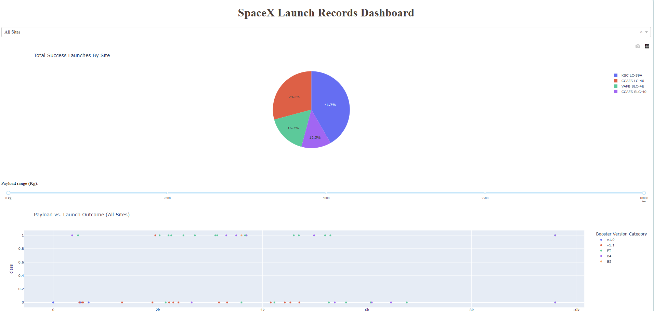
Build a Dashboard with Plotly Dash
Launch Site Markers – Plotted SpaceX launch sites to visualize geographic distribution.
Outcome Markers (Green/Red) – Indicated success (green) or failure (red) for each launch using MarkerCluster.
Circles (Site Influence) – Represented proximity zones (10 km radius) around launch sites to assess feasibility.
Polyline (Distance Mapping) – Connected launch sites to nearby coastlines, highways, railways, and cities, analyzing accessibility.
MousePosition Plugin – Enabled users to dynamically view latitude/longitude for precise distance calculations.
Popup Details – Embedded interactive labels for instant launch site insights
Folium,Advanced interactive Visualization - Github Link

Slide 15
Predictive Analysis (Classification)
Evaluation & Improvement
Accuracy Comparison:
Logistic Regression: 83.33%
SVM: 83.33%
Decision Tree: 94.44% (Best Performing)
KNN: 83.33%
Confusion Matrix Analysis
Decision Tree chosen as final model
Model Development Process
Data Preparation
Loaded dataset (dataset_part_2.csv, dataset_part_3.csv)
Created target variable (Class)
Standardized features using StandardScaler
Train-Test Split
Split data into X_train, X_test, Y_train, Y_test (80-20 split)
Model Selection & Hyperparameter Tuning
Logistic Regression (GridSearchCV for C, penalty, solver)
Support Vector Machine (GridSearchCV for kernel, C, gamma)
Decision Tree (GridSearchCV for criterion, max_depth, splitter)
K-Nearest Neighbors (GridSearchCV for n_neighbors, algorithm, p)
Data Prep
Train-Test Split
Hyperparameter Tuning
Evaluation
Best Model Selection

Slide 16
Results
Exploratory data analysis results
Interactive analytics demo in screenshots
Predictive analysis results

Slide 17

Section 2

Slide 18
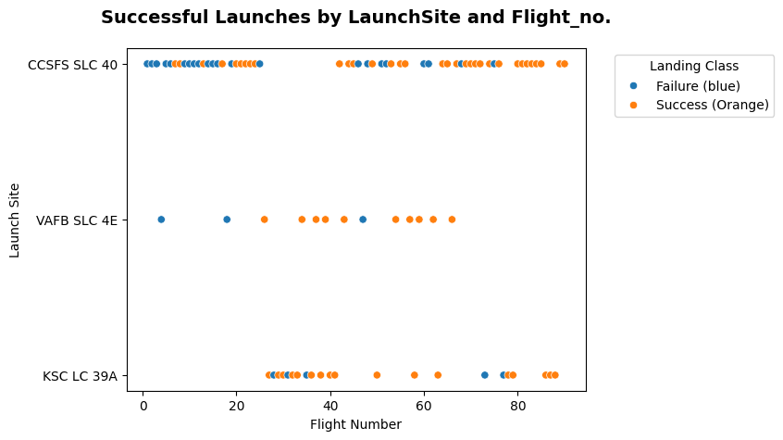
Flight Number vs. Launch Site
Higher flight numbers generally show an increased success rate, especially at sites like Cape Canaveral, indicating learning and optimization over multiple launches.
VAFB-SLC has relatively fewer launches, possibly due to its focus on specific missions, while KSC and CCAFS support frequent launches with varied success rates.
Early flights at most sites show lower success rates, reinforcing the trend that experience leads to better outcomes in landing reliability.

Slide 19
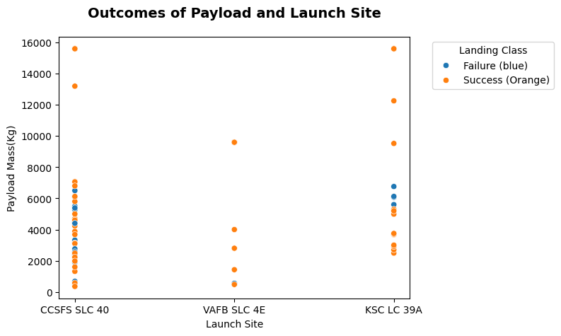
Payload vs. Launch Site
VAFB-SLC primarily handles lighter payloads (below 10,000 kg), suggesting its missions are focused on smaller satellites or specialized low-mass payload deployments.
Heavy payload launches (above 10,000 kg) are concentrated at Cape Canaveral and Kennedy Space Center, which are equipped for larger missions requiring higher thrust and recovery infrastructure.
VAFB-SLC may be optimized for polar or sun-synchronous orbits, making it less suited for missions involving massive payloads that need different orbital characteristics.

Slide 20
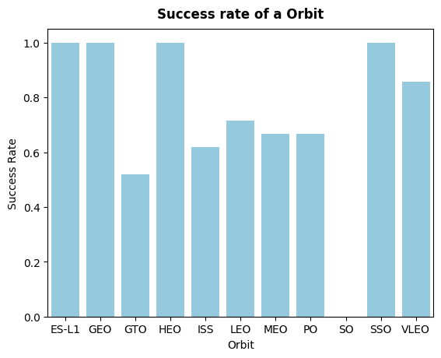
Success Rate vs. Orbit Type
LEO (Low Earth Orbit) has the highest success rate, making it the most reliable orbit for successful landings.
ISS (International Space Station) and SSO (Sun-Synchronous Orbit) also show strong success rates, indicating stable performance for missions targeting these orbits.
GTO (Geostationary Transfer Orbit) has a relatively lower success rate, suggesting challenges in achieving successful landings for this orbit type.

Slide 21
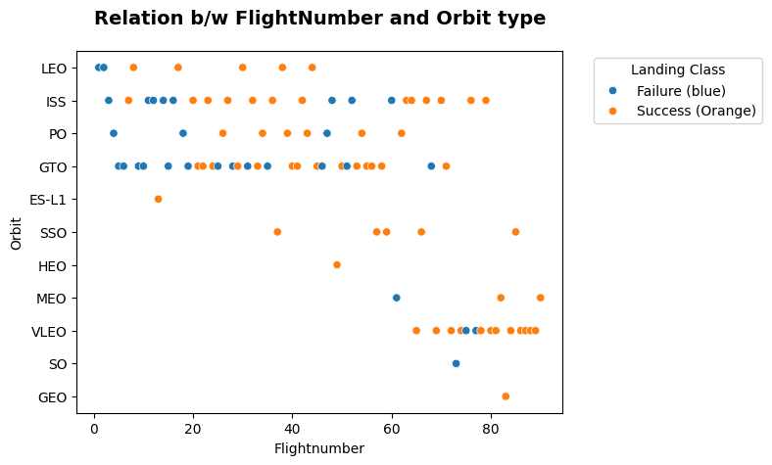
Flight Number
vs. Orbit Type
LEO (Low Earth Orbit) shows an increasing trend in success rate with higher flight numbers, indicating that experience and iterative improvements contribute to better landing outcomes.
GTO (Geostationary Transfer Orbit) does not show a clear relationship between flight number and success, suggesting that other factors, like payload complexity, might play a bigger role.
Polar and ISS orbits have moderate success rates across different flight numbers, showing stable performance but without a distinct upward trend.

Slide 22
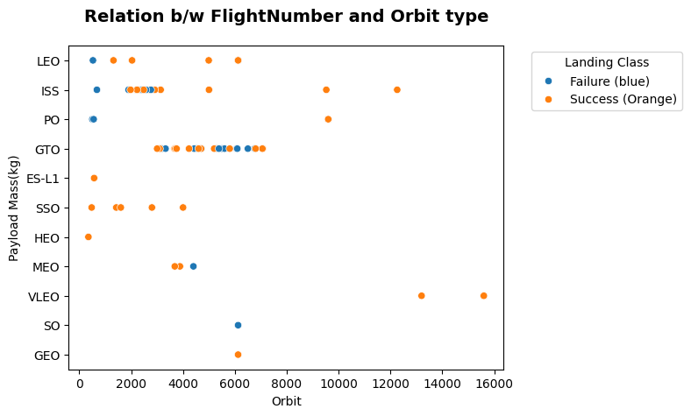
Payload vs. Orbit Type
Low payloads (<5000 kg) succeed consistently in LEO, ISS, and Polar orbits, reinforcing their suitability for smaller payload missions.
Mid-range payloads (5000-10,000 kg) show stable performance, especially in LEO and SSO, maintaining high success rates across launches.
Heavy payloads (>10,000 kg) have mixed results, with LEO and ISS adapting well, while GTO struggles due to complex trajectory challenges.

Slide 23
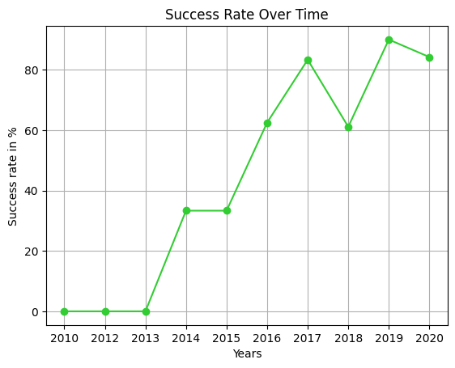
Launch Success Yearly Trend
Success rates have steadily increased since 2013, reflecting improvements in technology and operational efficiency.
A peak trend around 2020 indicates a period of high reliability, likely due to refined landing techniques and reusability optimizations.

Slide 24
All Launch Site Names
Query
%sql SELECT DISTINCT Launch_site from SPACEXTABLE;
Launch_Site
CCAFS LC-40
VAFB SLC-4E
KSC LC-39A
CCAFS SLC-40

Slide 25
Launch Site Names Begin with 'CCA'
Query
Find 5 records where launch sites begin with `CCA`
%sql SELECT * from SPACEXTABLE WHERE Launch_site like "CCA%" LIMIT 5;
Date | Time (UTC) | Booster_Version | Launch_Site | Payload | PAYLOAD_MASS__KG_ | Orbit | Customer | Mission_Outcome | Landing_Outcome
2010-06-04 | 18:45:00 | F9 v1.0 B0003 | CCAFS LC-40 | Dragon Spacecraft Qualification Unit | 0 | LEO | SpaceX | Success | Failure (parachute)
2010-12-08 | 15:43:00 | F9 v1.0 B0004 | CCAFS LC-40 | Dragon demo flight C1, two CubeSats, barrel of Brouere cheese | 0 | LEO (ISS) | NASA (COTS) NRO | Success | Failure (parachute)
2012-05-22 | 7:44:00 | F9 v1.0 B0005 | CCAFS LC-40 | Dragon demo flight C2 | 525 | LEO (ISS) | NASA (COTS) | Success | No attempt
2012-10-08 | 0:35:00 | F9 v1.0 B0006 | CCAFS LC-40 | SpaceX CRS-1 | 500 | LEO (ISS) | NASA (CRS) | Success | No attempt
2013-03-01 | 15:10:00 | F9 v1.0 B0007 | CCAFS LC-40 | SpaceX CRS-2 | 677 | LEO (ISS) | NASA (CRS) | Success | No attempt

Slide 26
Total Payload Mass
Calculate the total payload carried by boosters from NASA
Query
%%sql SELECT SUM(PAYLOAD_MASS__KG_) as Total_payload
FROM SPACEXTABLE
WHERE Customer = 'NASA (CRS)';
Total_payload
45596

Slide 27
Average Payload Mass by F9 v1.1
Calculate the average payload mass carried by booster version F9 v1.1
Present your query result with a short explanation here
Query
#average payload mass carried by booster version F9 v1.1
%%sql SELECT Round(AVG(PAYLOAD_MASS__KG_),2) as Average_payload
FROM SPACEXTABLE
WHERE Booster_Version like 'F9 v1.1%';
Average_payload
2534.67

Slide 28
First Successful Ground Landing Date
Find the dates of the first successful landing outcome on ground pad
Present your query result with a short explanation here
Query
%sql ALTER TABLE SPACEXTABLE MODIFY COLUMN Date DATE;
%sql SELECT MIN(Date) as first_launch_date FROM SPACEXTABLE WHERE Mission_Outcome LIKE '%SUCCESS%';
first_launch_date
2010-06-04

Slide 29
Successful Drone Ship Landing with Payload between 4000 and 6000
List the names of boosters which have successfully landed on drone ship and had payload mass greater than 4000 but less than 6000
%%sql
SELECT * FROM SPACEXTABLE WHERE PAYLOAD_MASS__KG_ > 4000
AND PAYLOAD_MASS__KG_ < 6000
AND Landing_Outcome LIKE '%Success (drone ship)%' ;
Date | Time (UTC) | Booster_Version | Launch_Site | Payload | PAYLOAD_MASS__KG_ | Orbit | Customer | Mission_Outcome | Landing_Outcome
2016-05-06 | 5:21:00 | F9 FT B1022 | CCAFS LC-40 | JCSAT-14 | 4696 | GTO | SKY Perfect JSAT Group | Success | Success (drone ship)
2016-08-14 | 5:26:00 | F9 FT B1026 | CCAFS LC-40 | JCSAT-16 | 4600 | GTO | SKY Perfect JSAT Group | Success | Success (drone ship)
2017-03-30 | 22:27:00 | F9 FT B1021.2 | KSC LC-39A | SES-10 | 5300 | GTO | SES | Success | Success (drone ship)
2017-10-11 | 22:53:00 | F9 FT B1031.2 | KSC LC-39A | SES-11 / EchoStar 105 | 5200 | GTO | SES EchoStar | Success | Success (drone ship)

Slide 30
Total Number of Successful and Failure Mission Outcomes
Calculate the total number of successful and failure mission outcomes
%sql Select Mission_Outcome,Count(*) AS No_of_attempts from SPACEXTABLE GROUP BY Mission_Outcome;
Mission_Outcome | No_of_attempts
Failure (in flight) | 1
Success | 98
Success | 1
Success (payload status unclear) | 1

Slide 31
Boosters Carried Maximum Payload
List the names of the booster which have carried the maximum payload mass
Present your query result with a short explanation here
%sql ALTER TABLE SPACEXTABLE ADD COLUMN Booster VARCHAR(10);
%sql UPDATE SPACEXTABLE SET Booster = SUBSTR(Booster_Version, 1, 5);
%sql Select Booster,MAX(PAYLOAD_MASS__KG_) from SPACEXTABLE GROUP BY Booster ORDER BY PAYLOAD_MASS__KG_ desc;
Booster | MAX(PAYLOAD_MASS__KG_)
F9 B5 | 15600
F9 FT | 9600
F9 B4 | 9600
F9 v1 | 4707

Slide 32
2015 Launch Records
List the failed landing_outcomes in drone ship, their booster versions, and launch site names for in year 2015
%sql SELECT SUBSTR(Date,6,2) AS Month ,Landing_Outcome,Booster_Version,Launch_site from SPACEXTABLE WHERE Landing_Outcome LIKE "Failure%" AND SUBSTR(Date,0,5)='2015';
Month | Landing_Outcome | Booster_Version | Launch_Site
01 | Failure (drone ship) | F9 v1.1 B1012 | CCAFS LC-40
04 | Failure (drone ship) | F9 v1.1 B1015 | CCAFS LC-40

Slide 33
Rank Landing Outcomes Between 2010-06-04 and 2017-03-20
Rank the count of landing outcomes (such as Failure (drone ship) or Success (ground pad)) between the date 2010-06-04 and 2017-03-20, in descending order
%%sql SELECT Landing_Outcome, COUNT(*) AS Outcome_Count
FROM SPACEXTABLE
WHERE Date BETWEEN '2010-06-04' AND '2017-03-20'
GROUP BY Landing_Outcome
ORDER BY Outcome_Count DESC;
Landing_Outcome | Outcome_Count
No attempt | 10
Success (drone ship) | 5
Failure (drone ship) | 5
Success (ground pad) | 3
Controlled (ocean) | 3
Uncontrolled (ocean) | 2
Failure (parachute) | 2
Precluded (drone ship) | 1

Slide 34

Section 3

Slide 35
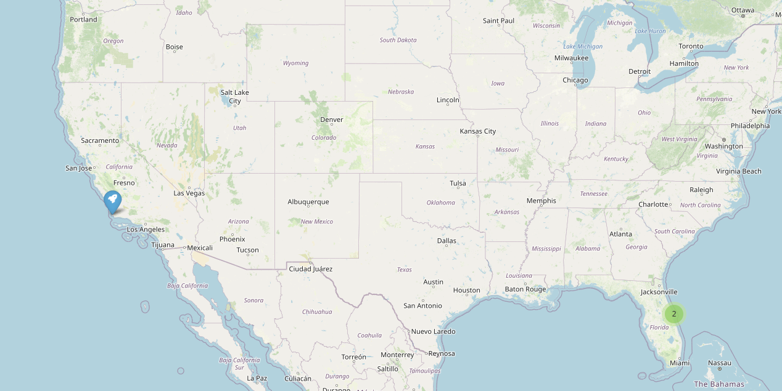
Launching sites Geomapping
Replace <Folium map screenshot 1> title with an appropriate title
Explore the generated folium map and make a proper screenshot to include all launch sites’ location markers on a global map
Explain the important elements and findings on the screenshot

Slide 36
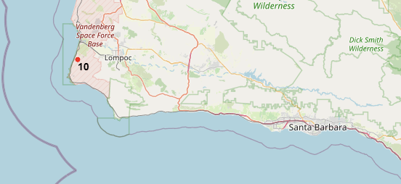
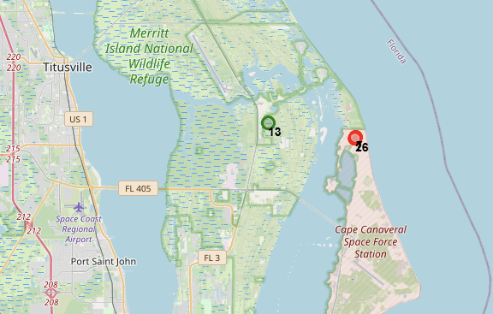
<Folium Map Screenshot 2>
Green succesrate is high
Red = less success

Slide 37
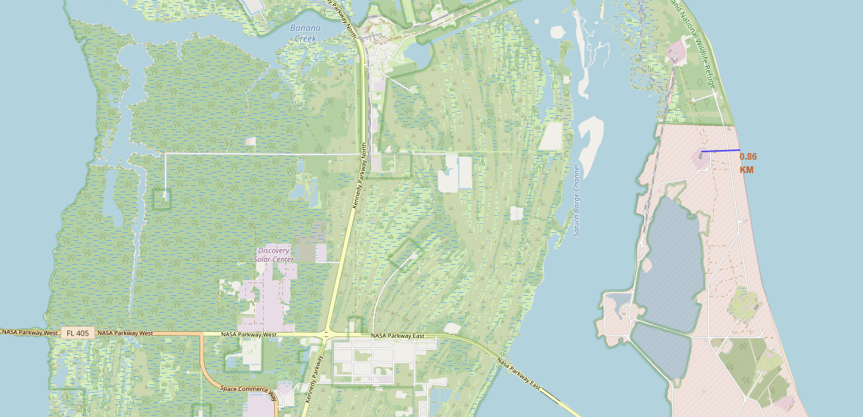
Coastal line to Launching Site distance
Replace <Folium map screenshot 3> title with an appropriate title
Explore the generated folium map and show the screenshot of a selected launch site to its proximities such as railway, highway, coastline, with distance calculated and displayed
Explain the important elements and findings on the screenshot

Slide 38

Section 4

Slide 39
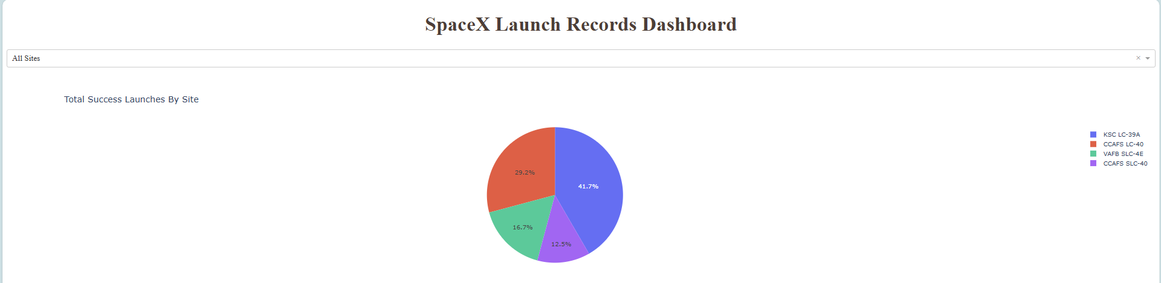
SpaceX Launch Dashboard

Slide 40

SpaceX Launch Dashboard

Slide 41
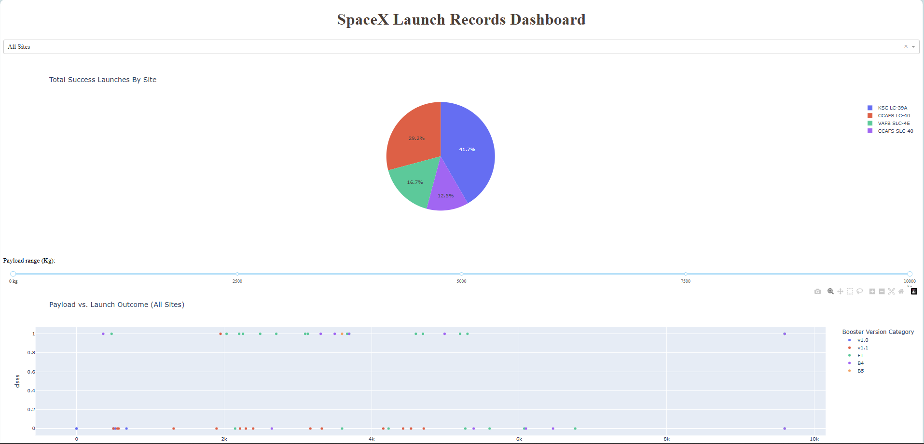
SpaceX Launch Dashboard

Slide 42

Section 5

Slide 43
Classification Accuracy
Visualize the built model accuracy for all built classification models, in a bar chart
Find which model has the highest classification accuracy
Logistic Regression: 83.33%
SVM: 83.33%
Decision Tree: 94.44% (Best Performing)
KNN: 83.33%

Slide 44


Confusion Matrix
GridSearchCV object with 10-fold cross-validation
Confusion matrix
KNN model
Confusion matrix

Slide 45
Conclusions
Accuracy Comparison:
Logistic Regression: 83.33%
SVM: 83.33%
Decision Tree: 94.44% (Best Performing)
KNN: 83.33%

Slide 46
Appendix
Include any relevant assets like Python code snippets, SQL queries, charts, Notebook outputs, or data sets that you may have created during this project

Slide 47


